Slide 1
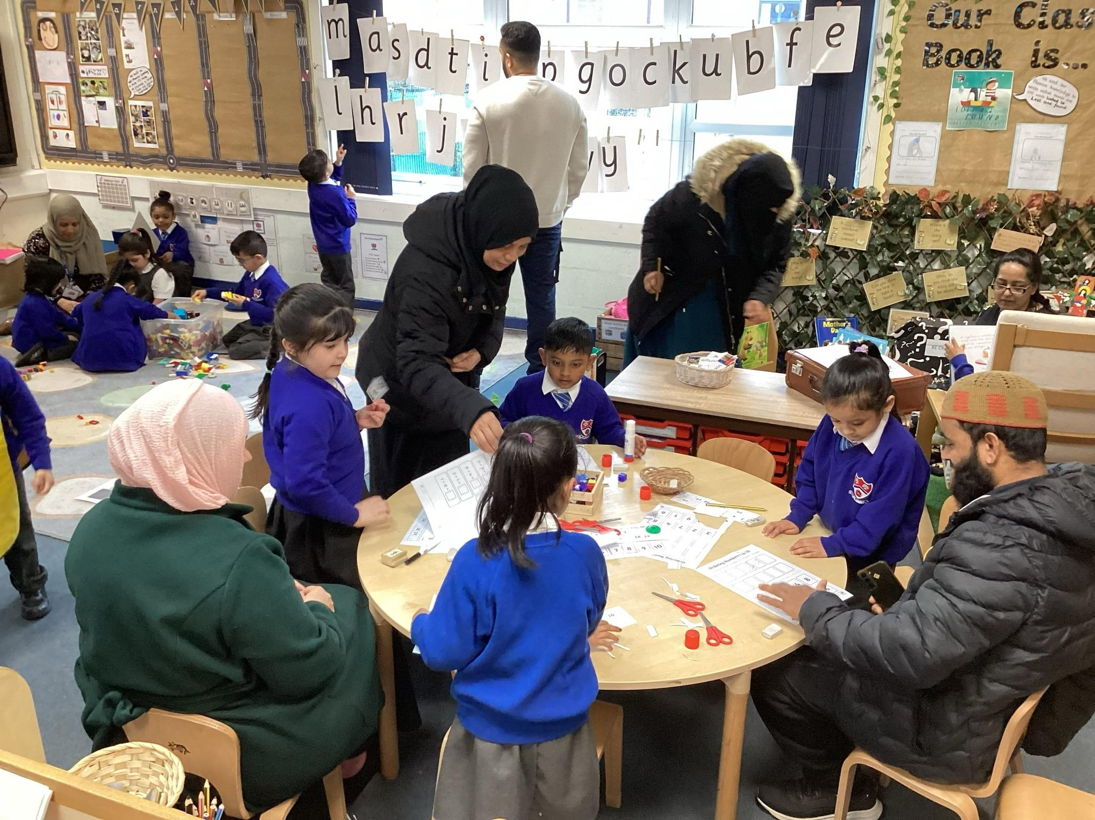


Welcome to our school!

Slide 2
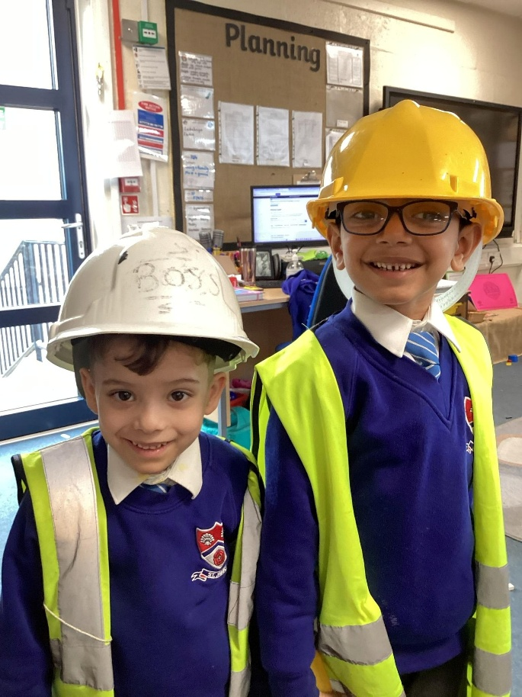
Purpose Of The Meeting
To help your child make the best possible start to school.
To understand the curriculum in the Early Years.
To explain the daily routine in Reception.
To be aware of the transitions from now – September.

Slide 3
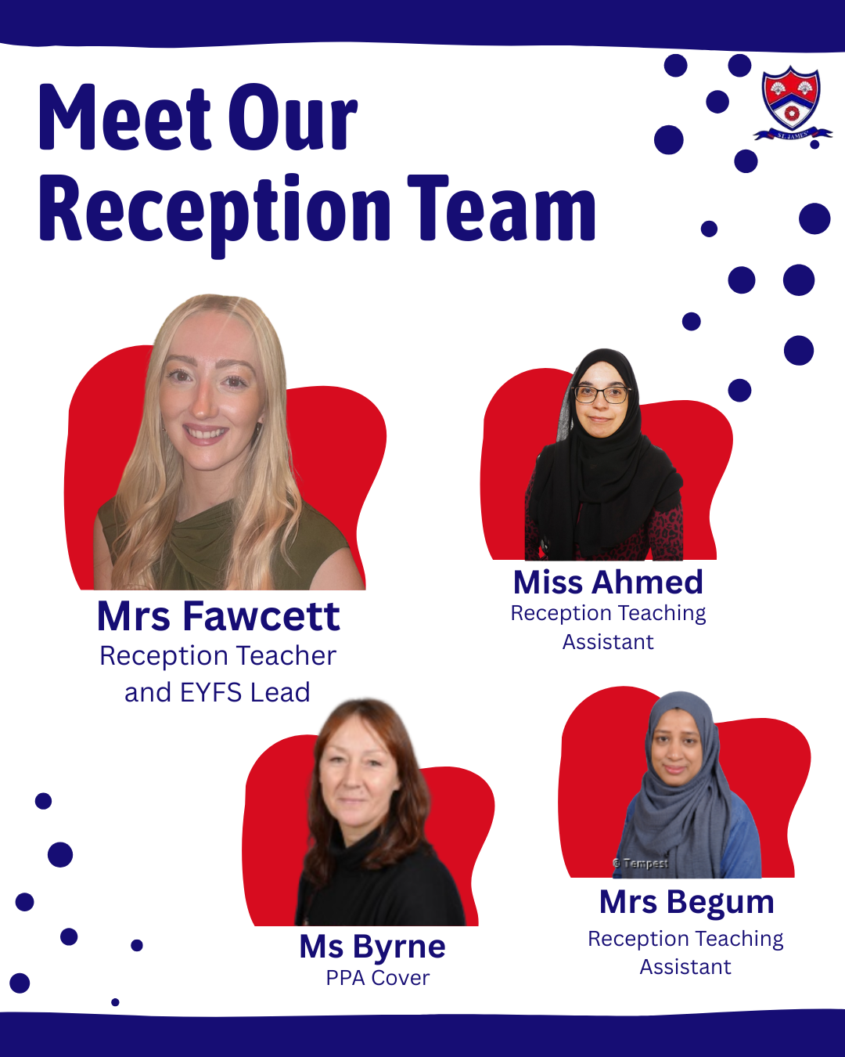
Teamwork makes the dream work!
Email the school office on:
office@haslingden-st-james.lancs.sch.uk

Slide 4
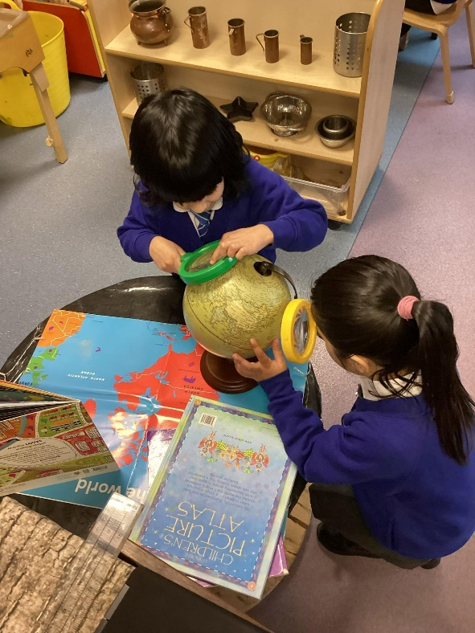
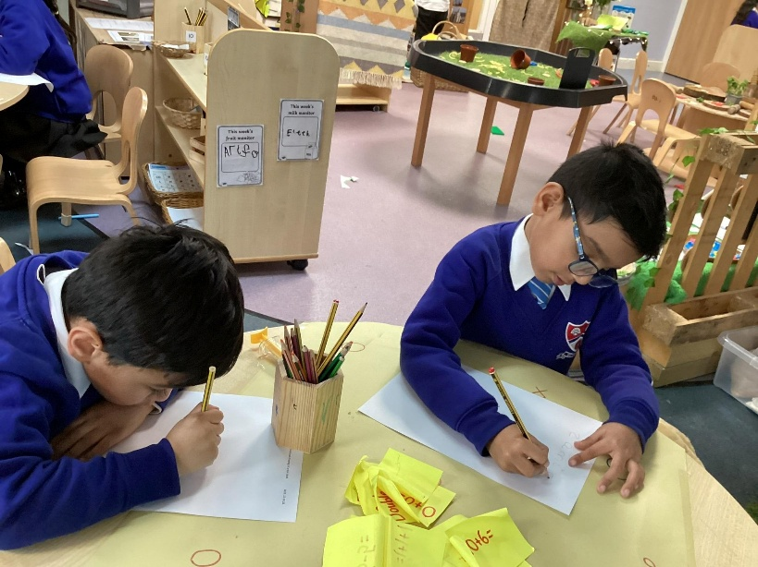
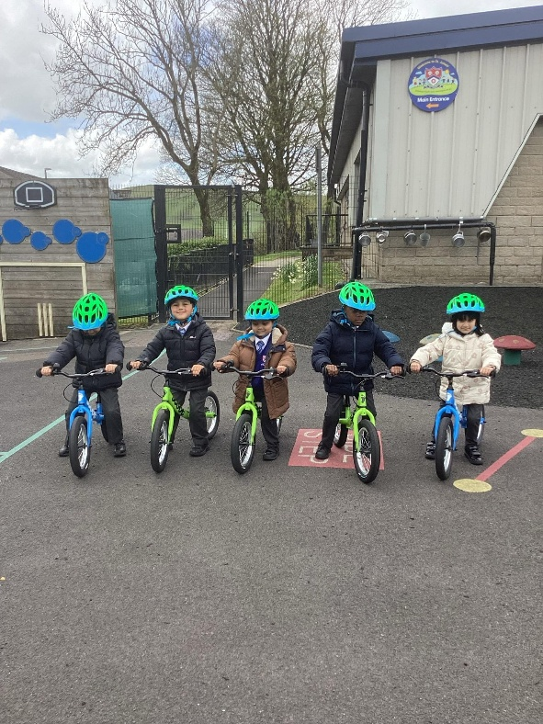
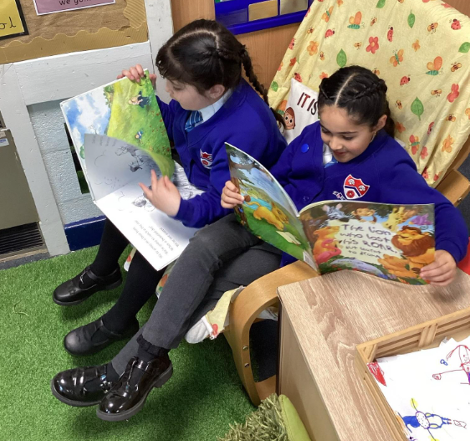
The EYFS Curriculum
The EYFS stands for Early Years Foundation Stage and is the curriculum for all children from birth to 5.
In 2021, this was updated with only the Early Learning Goals (ELGs) made statutory. The ELGs are where we would expect all children on track to be by the end of the Reception year.
The EYFS is split into 7 areas: 3 prime areas and 4 specific areas. The prime areas underpin the specific areas.
During parents evenings, we will update you on your child's progress within the curriculum. We use the terms 'on track’, 'working towards’ and ‘not on track/below’. This wording is also in the end of year reports.
In September, we are introducing a bespoke curriculum here at Haslingden St James’. Our curriculum allows for learning to reflect our children's interests as well as their strengths and next steps.

Slide 5
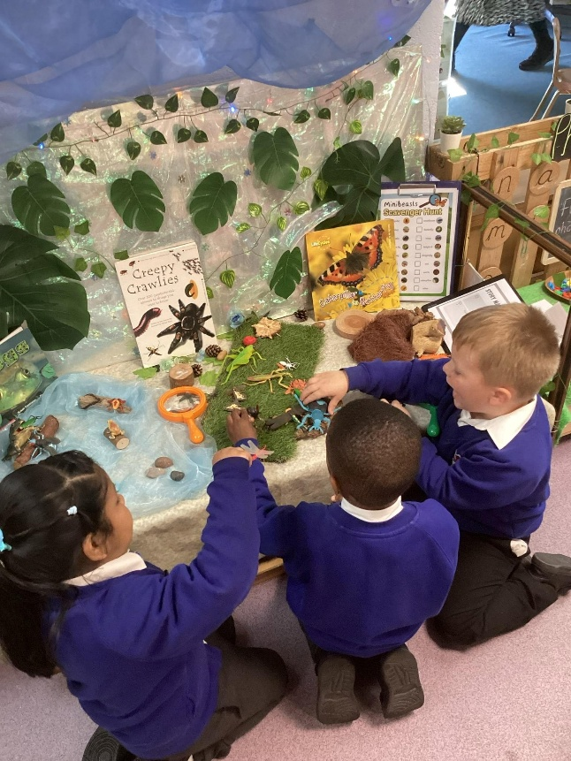
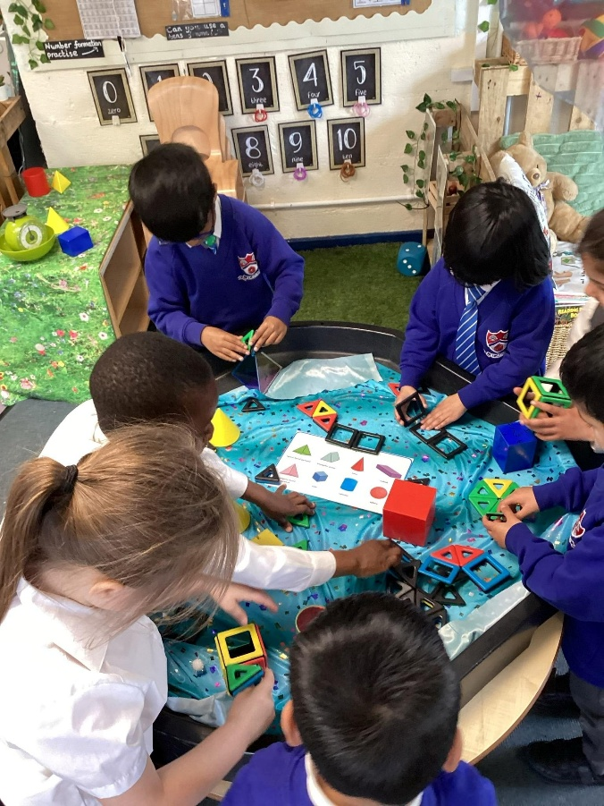
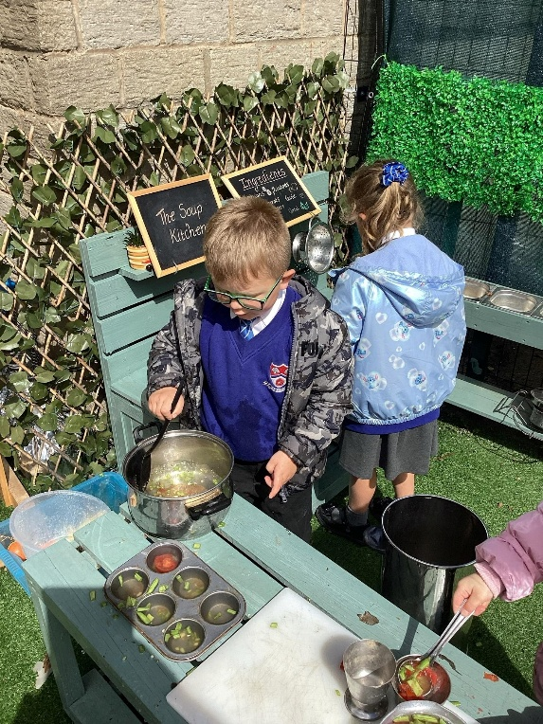
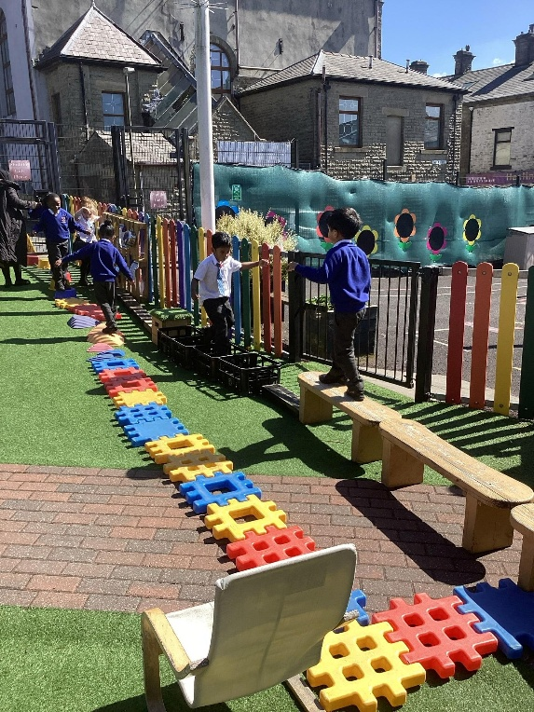
We change the indoor classroom provision on a weekly basis – half of the areas one week, and the other half the following week.
We change the outdoor classroom provision on a half-termly basis, based on your child's interests, their next steps, and the topic we are focusing on. This is bespoke for each cohort.
There is always a member of the team based in provision. This is invaluable. The role of the adult is to model high-quality language, scaffold children's learning, support their characteristics of effective learning and develop wonderfully fantastic relationships with our children. We use questioning, commentating and play to extend each child’s learning and to ensure progression.

Slide 6
The Reception school day
8:45 – 8:50: DOORS OPEN AND MORNING ACTIVITIES BEGIN
8:50 - 9:00: REGISTRATION AND DAILY TIMETABLE
9:00 – 9:25: WORSHIP AND READERS
9:30 – 10:00: PHONICS (RWI) AND HANDWRITING
10:00 – 10:15: BREAK TIME (INFANT PLAYGROUND)
10:15 – 10:30: SNACK TIME AND STORY TIME
10:30 – 11:30 – CONTINUOUS PROVISION (LITERACY & WORD TIME IN GROUPS)
11:30 – 11:55 – tidy up time followed by wonderful words or nursery rhyme time (INTERVENTIONS TAKING PLACE)
11:55 – 12:55: LUNCHTIME
12:55 – 13:00: BRAIN BREAK TIME AND REGISTRATION
13:00 – 13:20: MATHS INPUT (WRM)
13:20 – 13:40: WHOLE CLASS INPUT (RE/PSHE/TOPIC)
13:40 – 14:40: CONTINUOUS PROVISION (INDOOR & OUTDOOR)
MATHS GROUP WORK
TOPIC GROUP WORK
RE GROUP WORK
14:40 – 14:50: KEY PERSON TIME
14:50 – 15:20: STORY TIME THEN PREPARE FOR HOMETIME
15:20: HOMETIME

Slide 7
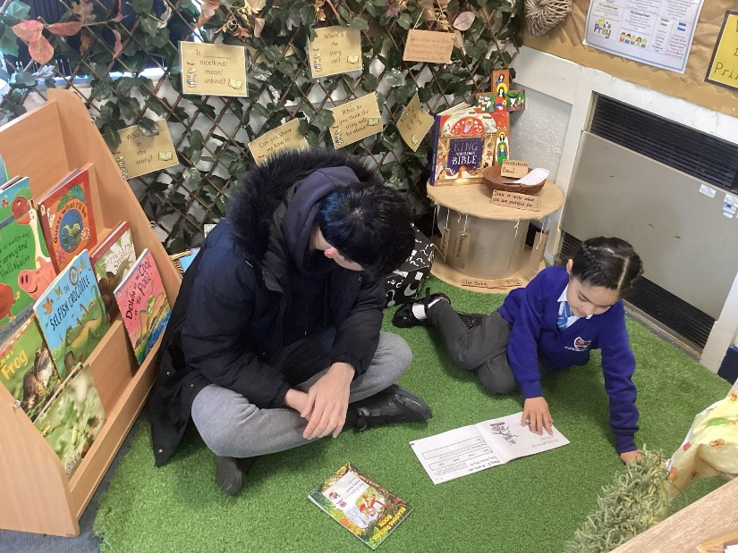
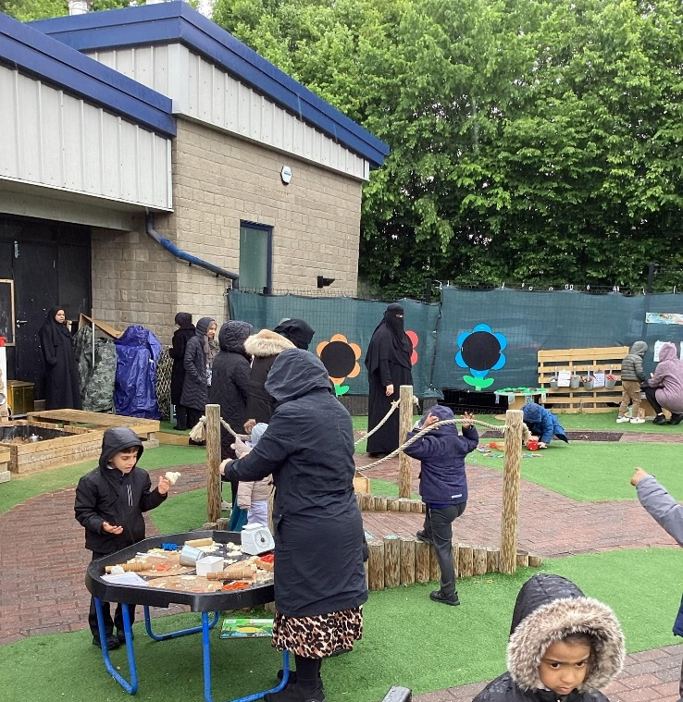
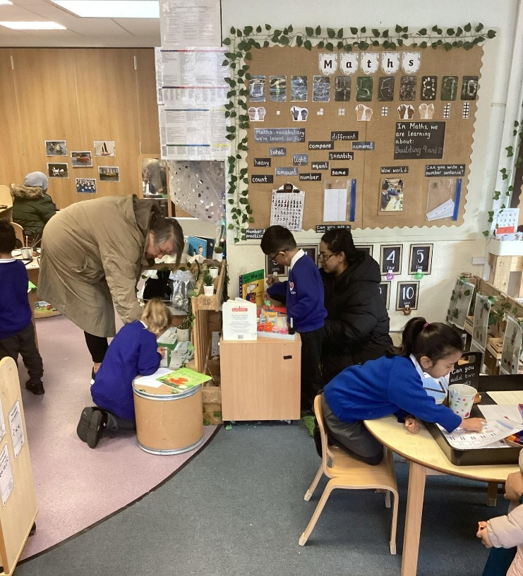
Parental Partnership
Pop in & play sessions - fortnightly
Parent's evenings
Parent voice
Real life superheroes – we need you!
Sport's Day
EYFS Nativity
PTFA meetings and events
Fundraisers
Weekly school newsletters
Half-termly EYFS newsletters
EYFS Parent notice board
ClassDojo updates – Photos and messages

Slide 8

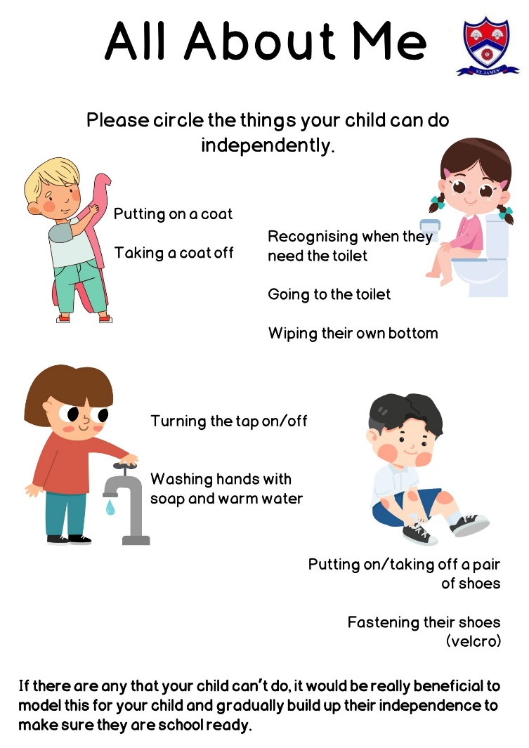
Welcome Packs
Your child’s blue book bag contains all the information you need to know.
Documentation – please complete and return to school when it is your child’s first transition session (Thursday 2nd July) – to ensure a smooth transition for your child.
Use this documentation to help you prepare your child for school. Any areas that they struggle with, support your child to achieve this so that they are school ready.
Attendance – your child’s first year at school is absolutely crucial to their future. Please be on time and attend school everyday. Appointments are to be made outside of school times where possible.

Slide 9
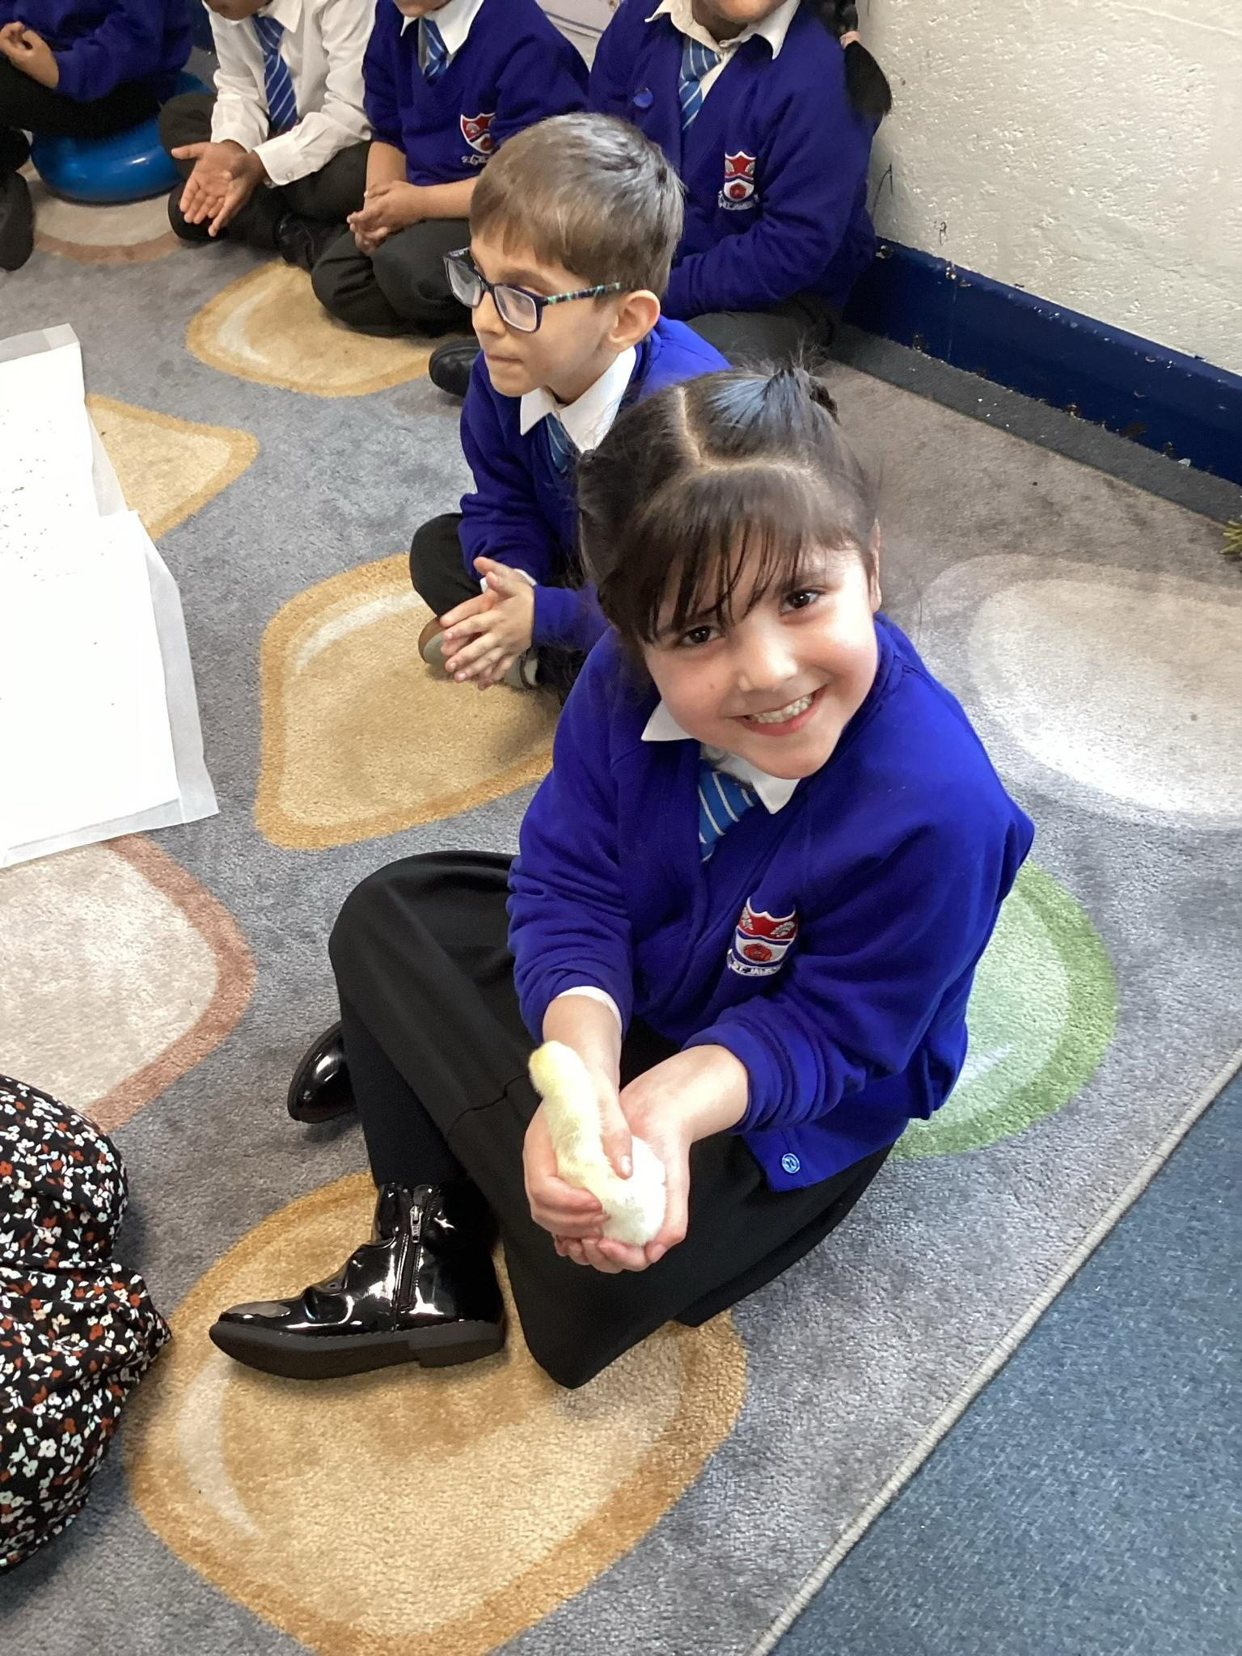
Uniform
Grey skirt or grey trousers
White short sleeved shirt and school tie
Blue jumper or cardigan with logo
Black school shoes (velcro and not laces)
Black, grey or white socks or black or grey tights
Appropriate hairstyles – hair up for children with long hair
Please label all items with your child’s name.

Slide 10
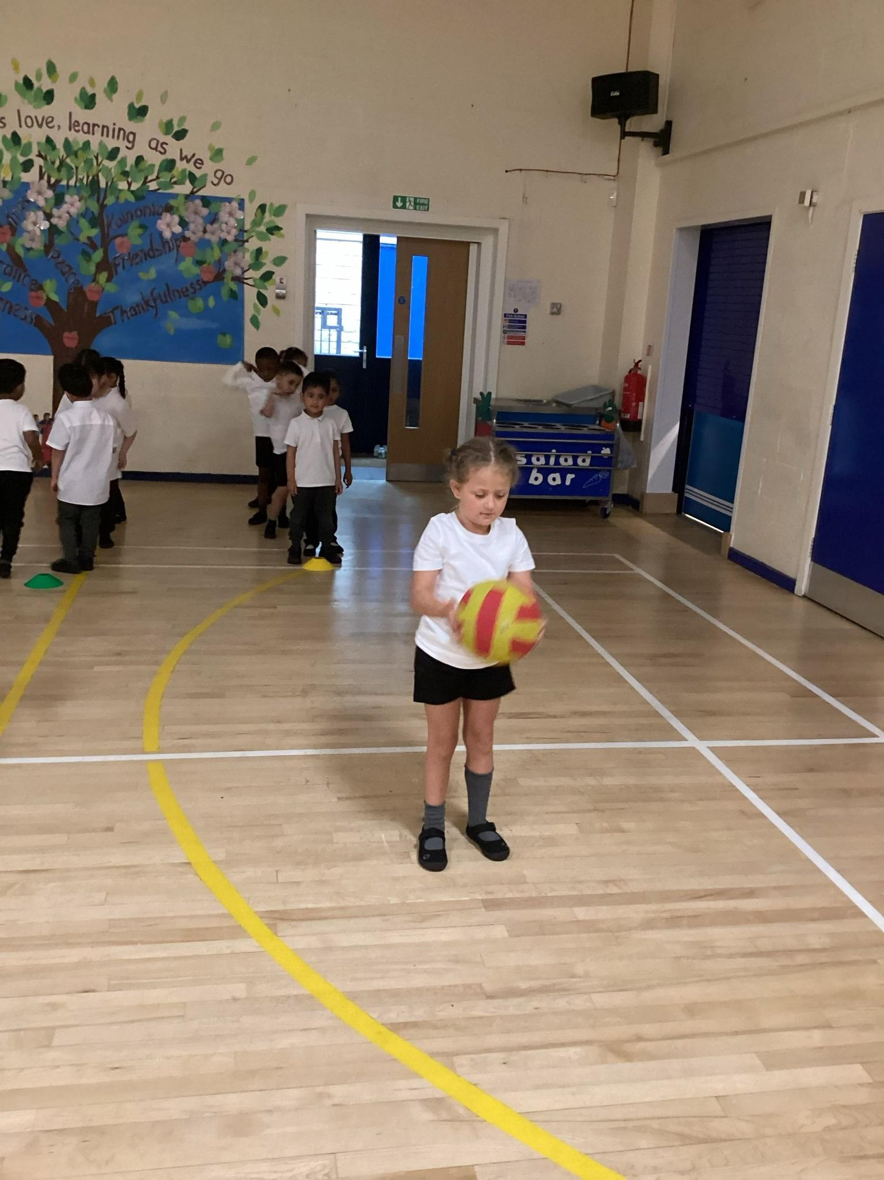
PE Kit
Black shorts/leggings or joggers
White round neck t-shirt
Black pumps
Please send PE kits in a PE bag to stay in school.
Please label all items with your child’s name.

Slide 11
Frequently Asked Questions
What time does school start and finish?
What will my child need?
Doors open at 8:45 and close at 8:50 for the register. The end of the day is at 3:20.
All children need the following:
A water bottle
A coat with a working zip and a hood
A bag with a spare change of clothes (full – jumper/cardigan, socks/tights, underwear, skirt/dress/trousers, shirt). This will remain at school and will only come home when necessary (if your child has an accident – water play or toileting).
Children are encouraged to bring a book bag each day – this can have letters in, library book, and home reading books with your child’s reading record.
PE kit (as per last slide) to stay in school
Everything needs to be clearly labelled with your child's name.
Children have 3 options daily. In your welcome packs, there is a copy of the menu so you can see the types of meals that we offer. School dinners are free for children in Reception. This continues in Year 1 and Year 2.
Anything else to know?
What do they have for lunch?

Slide 12
Who do I contact?
If someone else is picking my child up?
Anyone who might pick your child up on a regular basis (except parents/guardians) should be added to the collection consent form. If their name isn't on the collection consent form, contact the school office. Please ensure this person has the password.
If my child is absent?
Call the school office and leave a message.
If my child is arriving late/leaving early for an appointment?
Contact the school office and let the class teacher know.
About financial questions such as paying for a school trip or an event?
Contact Miss Brewer, school bursar (office@haslingden-st-james.lancs.sch.uk)
To let you know our address or phone number has changed?
Speak to Mrs Lambert, school business support (c.lambert@haslingden-st-james.lancs.sch.uk

Slide 13
What's next?
NOW...
Looking around your child's classroom, and asking any other questions you might have.
NEXT...
Your child's transition sessions: Thursday 2nd July 9:30-11:30am and Tuesday 7th July, 2 – 3pm.
Drop your child off at the school office unless the children are at St James’ Nursery already. Collect your child from the school office. Children who attend St James’ Nursery to be collected at the usual time from the Nursery gate at 11.50am.
Please bring your child’s completed paperwork to the first transition session on Thursday 2nd July.
LATER...
Thursday 9th July – School summer fair – all welcome! This is at 2-4pm.
FINALLY...
Your child starts school with us in September! School re-opens on Wednesday 2nd September.
Half the class will attend AM on Wednesday 2nd September, and the other half will attend PM.
Half the class will attend AM on Thursday 3rd September, and the other half will attend PM.
The whole class will attend for the full day on Friday 4th September.

Slide 14
Thank you so much for your time.
We look forward to getting to know you and your child as they start their educational journey with us!
A copy of this PowerPoint will be added to the school website: www.haslingden-st-james.lancs.sch.uk - Parents - New starters 26/27

