Slide 1








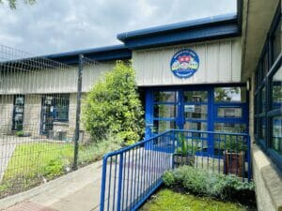
Haslingden St James CE Primary School
School Brochure
2025-2026
Regent Street, Haslingden, BB4 5HQ
School Office 01706 214 134
Email: office@haslingden-st-james.lancs.sch.uk
https://haslingden-st-james.lancs.sch.uk/

Slide 2
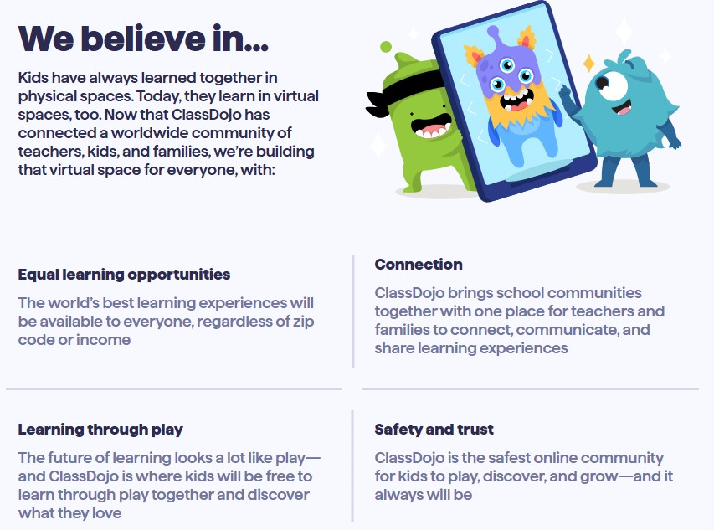

Contents
Welcome | Page 3
Our School & The Governors | Page 4
Our Staff | Page 5
Our School Vision, Aims & Values | Page 6
The School Day, Attendance & Punctuality | Page 7
Breakfast & After School Extracurricular Activity Clubs | Page 8
Being Equipped for the Day | Page 9
Links with St James Church & Collective Worship | Page 10
School Uniform | Page 11
Lunch | Page 12
Financial Support | Page 13
SEND & Family Support | Page 14

Slide 3
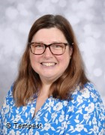
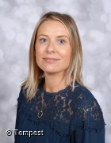
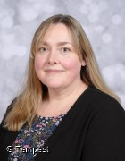
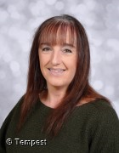
A very warm welcome to the family of Haslingden St. James’
C of E Primary School.
At St. James’ we aim to provide a secure, caring and stimulating environment in which children are encouraged to strive to do their very best in all aspects of their development. We believe that courtesy, respect and concern for others are as important as high standards of achievement in academic work. To this end, we strive to meet the needs of every child, recognising that each child is unique and deserves to be celebrated as such.
Our school is much more than just a building where young children are taught. We are a warm, welcoming and flourishing family community of children and adults who actively encourage parents to become involved in their children’s education and firmly believe that home and school need to work in partnership for the benefit of our children.
I invite you to join our school family, in partnership, to secure the very best that we can offer for our children.
Miss Frances Brady
Headteacher
Our Mission Statement
To provide a high quality of education for all our children, within a Christian environment.
Our Motto
Developed by the children, 'Growing in God's love, learning as we go'
Senior Leadership Team
Miss Frances Brady
Headteacher
Mrs Andrea Humberstone
Deputy Headteacher
Mrs Kathryn Jamil
SENCO
Miss Lou Brewer
School Business Manager

Slide 4
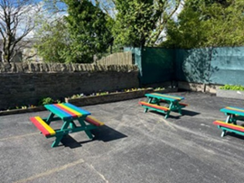
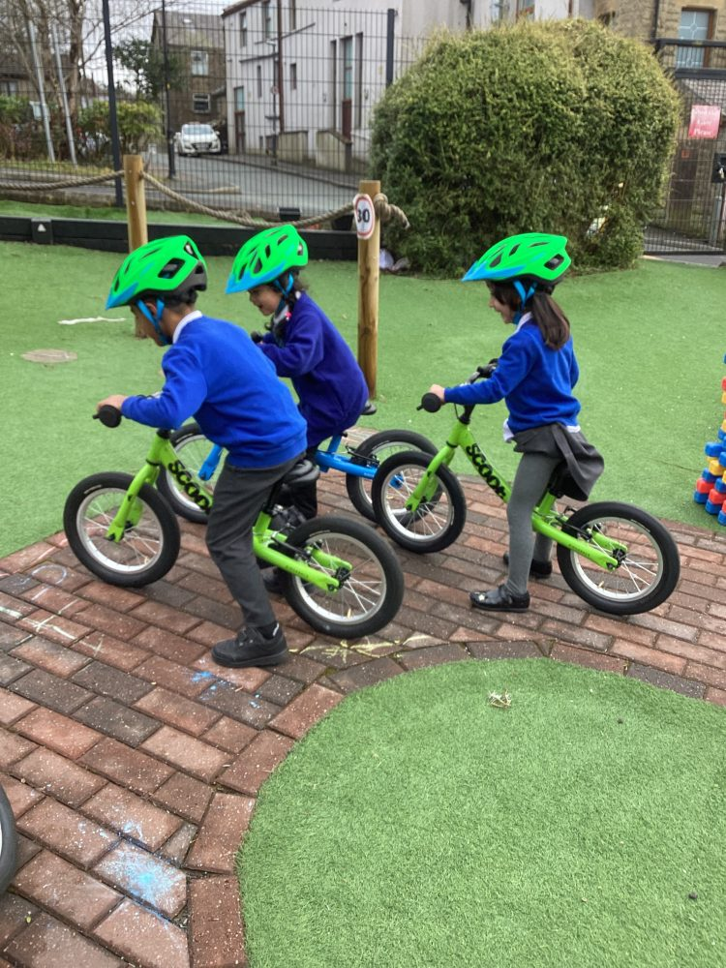
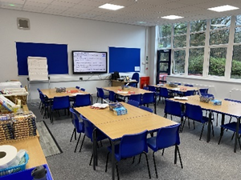
Our School
St. James’ offers nursery and primary education to children aged 3 – 11 years. The school is situated on a pleasant site on the edge of Haslingden. The present school building was opened in 1982 and the nursery class was opened in 1997.
In recent years, many improvements have been made to the school building, including the complete re-build of a 2 classroom wing and refurbishment of all toilets completed 2025.
The school grounds include separate playgrounds for infants and junior children and a well-planned, enclosed and colourful outdoor area for our Nursery and Reception children. There is also an all-weather pitch and areas with seating and planting, the ‘Reflective Garden’ provides an attractive, enclosed space for children to become involved in planting and growing and is used to support a range of curriculum activities and we have outdoor classrooms to promote alternative learning environments and opportunities to explore outdoor learning.
With a capacity for 210 4-11 year olds classes are organised into single classes with an additional 30 half day places for 3 year olds in our nursery.
The Governors
The Governing Body are the employers of the school. They work in partnership with the Headteacher to make decisions about how the school is run to improve the quality of education provided for the children. The full Governing Body meets each term, as do its committees, to discuss matters relating to the curriculum, staffing, buildings and finance. Led by Paul Adnitt, the governing body comprises representatives from the local parish, non-staff, staff and parent members. New parent members are always warmly welcomed.

Slide 5
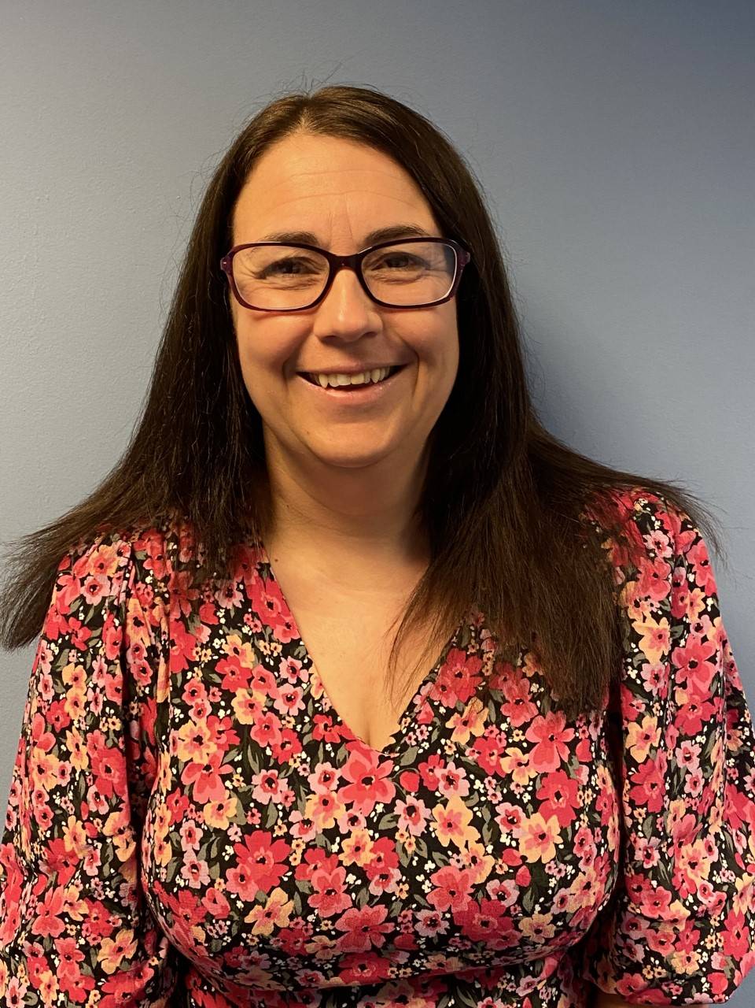
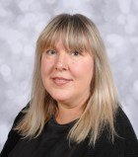
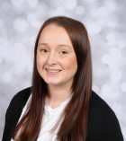
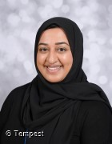
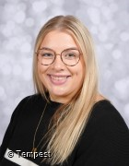
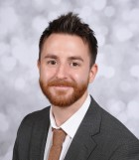
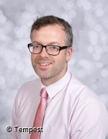
Our Staff
We are proud to have a diverse team with many long-serving members of teaching staff and support.
Class | Teacher | Support | SEN & Wellbeing Team
Nursery | Miss C Crilly | Miss H Fraser (AM) Mrs S Khan (AM) | Mrs R Ahmed
EYFS | Mrs V Molloy | Mrs J Begum Miss C Crilly (PM)
Year 1 | Miss C Dunne | Miss K Collinge
Year 2 | Miss S Arshad | Mrs A Eynon | Mrs C Morton
Year 3 | Miss E Dawson | Mrs A McMahon
Year 4 | Miss K Pickering | Mrs S Ahsan | Miss S Byrne
Year 5 | Mr M Marren | Mrs K Hayhurst
Year 6 | Mr K Simister | Mr I Fraser
Headteacher – Miss F Brady
Deputy Headteacher – Mrs A Humberstone
SENCO – Mrs K Jamil
School Business Manager – Miss L Brewer
Office Assistant – Mrs Z Wild
School Caretaker – Mr I McNeill
School Cleaner – Mrs S Bibi
Breakfast Club – Miss S Byrne and Mrs C Statham
Lunchtime Supervisors – Mrs Jahan, Mrs R Begum, Mrs S Begum, Ms Healy
Kitchen Staff – Mrs L Marshall, Mrs F Begum, Mrs T Jahan, Mrs S Begum, Mrs R Begum
Maternity Leave until summer term 2026 – Mrs J Khan and Mrs Z Khan

Slide 6
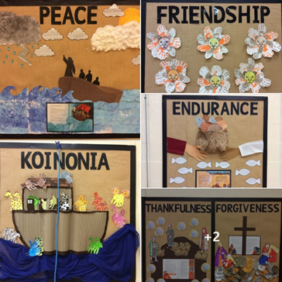
Our School Vision, Aims and Values
Vision: “We love because he first loved us.” – 1 John 4:19
We are a safe, loving, supportive, Christian family which values each child’s individuality and uniqueness created in the image of God. We nurture the talents given by God to inspire pupils to achieve and succeed, and foster a sense of awe and wonder of God’s world:
Form foundations of lifelong faith through Gospel values and sincere, meaningful prayer.
Guide Pupils to determine their own personal moral values, and a respect and understanding of other races, religions and ways of life.
Develop future citizens who cherish the world in which they live and their responsibilities within it.
A curriculum which has a breadth of experience and equality of opportunity for all.
Aims
To create a safe, caring, supportive, stimulating and Christian ethos and environment in which individuals can develop;
To value each child as an individual;
To challenge and excite each child to reach their full potential;
To encourage a love for and an enjoyment of learning;
To help children acquire knowledge, skills and understanding relevant to adult life and employment in a changing world;
To help children develop personal moral values, respect for religious values and an understanding of other races, religions and ways of life;
To help children understand the world in which they live and their responsibilities within it;
To develop a sense of awe and wonder;
To ensure the curriculum offers a breadth of experience and equality of opportunity for all children.
Values
Whilst our school seeks to reflect many Christian values, the following seven have been chosen as our 'Core Values'. We believe that an understanding of these values, and integration of them into school life, will help to equip our children as they forge relationships within our school community, the local community within Haslingden and society as a whole. Our core values are:
Endurance: Recognising that life is sometimes difficult and that it is important not to give up in the face of adversity.
Forgiveness: Understanding that forgiveness can be given and received, but that it must be genuine and from the heart.
Friendship: Knowing that true friendship breaks down barriers between people and enables everyone to grow as an individual.
Koinonia: 'Koinonia' means 'that which is in common'. It can be translated as 'fellowship' or 'community'. It encompasses the concept of interdependence: all within our school are needed and valued and each person is important to the whole community.
Peace: Working towards people living in harmony with themselves, with others, with God and creation.
Thankfulness: Seeing the world as God's creation and being thankful for it as a gift not a right.

Slide 7

The School Day
The school doors open at 8:45am so that children can come into school and settle down prior to the start of the school day.
The school day starts promptly at 8:50am
Worship takes place at 9:00am each day
Early Years have continuous access to the outdoor curriculum
KS1 morning playtime: 10:45-11:00am
Lower KS2 morning playtime 10.30-10.45am
Upper KS2 morning playtime: 10:45-11:00am
Lunch break: 12noon-13:00pm
Infant afternoon playtime: 14:00-14:15pm
School closes at 15:20pm
Your child must be dropped off and collected by an adult 16+ years old, only adults named on the collection record for the individual child will be allowed to collect your child. Only Year 5&6 are allowed to walk home without an adult – with signed permission from home.
Attendance and Punctuality
A good level of attendance is expected from all children at St. James’, as any time off school results in children missing a valuable part of their education. The school operates a First Day Response system whereby parents are expected to phone the school on the first day of absence. Where the school has not been notified by 9:30am, office staff will contact parents to establish the reason for absence.
There are a range of incentive schemes used in school to reward good attendance. Whilst we encourage all children to be in school for 8:50am, we understand that sometimes unexpected events occur which result in children being late for school. We would much rather that your children came into school late than not at all!
All dentist and doctors appointments should be made out of school hours where possible, however if your child has an unavoidable appointment, a copy of the appointment letter should be provided to school.

Slide 8
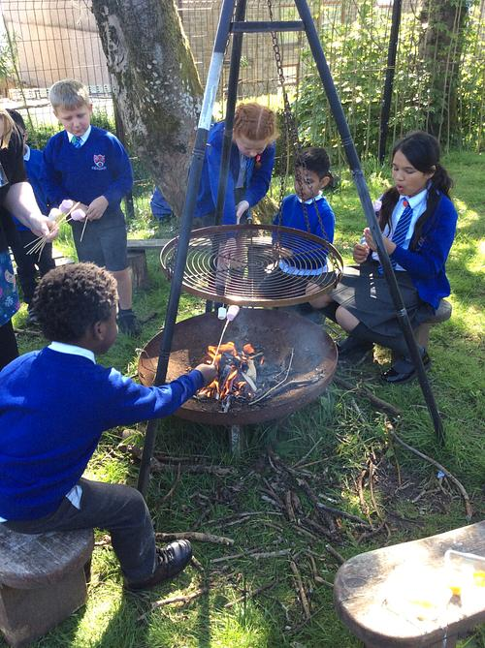
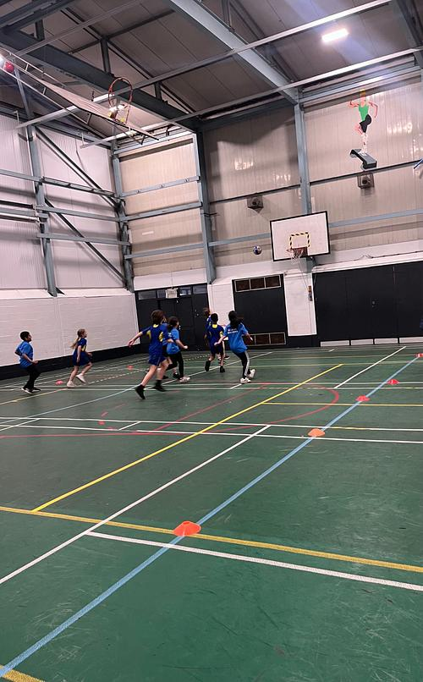
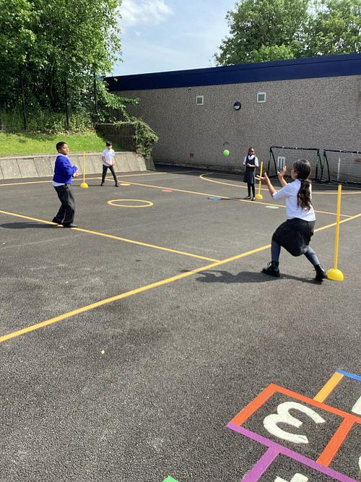
Breakfast and After School Extra Curricular Activities
A school staff led breakfast club operates daily from 8am for the token fee of £1.50 per child.
Children must arrive at breakfast club by 8.20 am to allow time for food prior to playing out. A selection of toast, cereals, jams and drinks are available. Booking is not required but it can be useful to let the office know should you require a regular place.
A program of after school activities runs daily for individual Key stages/Year groups. Some are hosted by Rossendale Leisure Trust or independent sports coaches, others are led by school staff. Such sessions are free of charge and places are allocated on a first come first served
After school activity clubs finish at 16.20 and change every half term meaning all age groups have an opportunity to explore extracurricular activities that may include baking, gymnastics, music, origami or gardening.
We also take part in Rossendale Leisure Trust Primary Schools sports program which allows children to participate in competitions with other local schools. Children are transported to several venues including The Valley Leadership Academy in Waterfoot giving them a sense of community sport.
Parental support with transportation and support for after school events is essential.

Slide 9
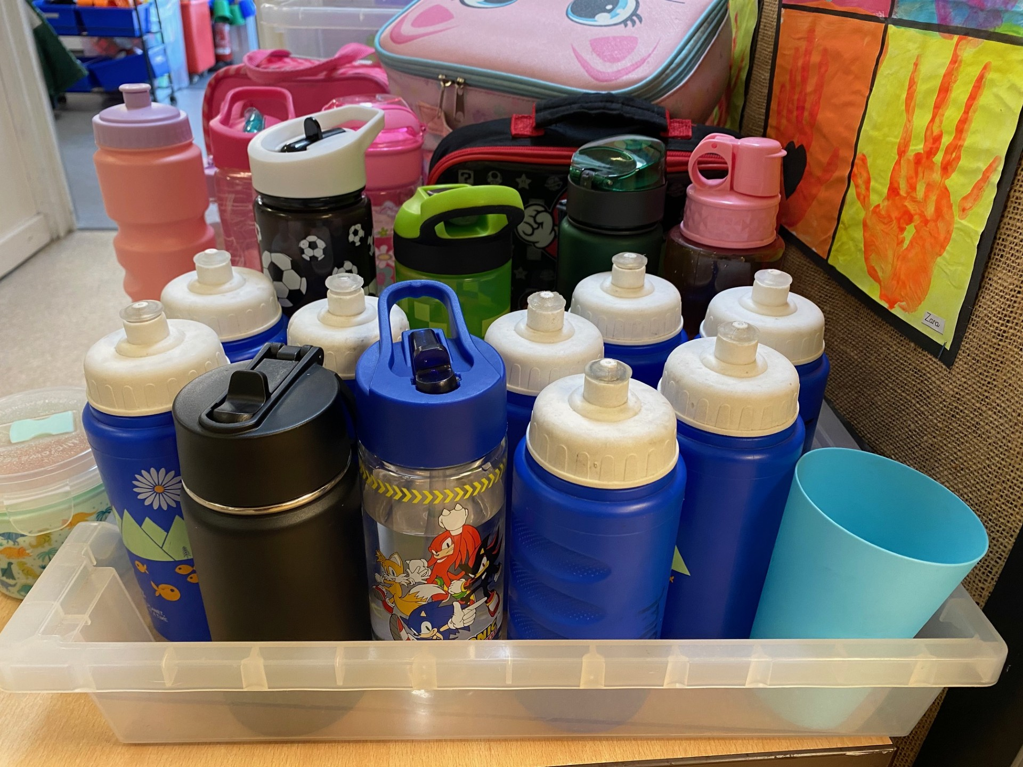
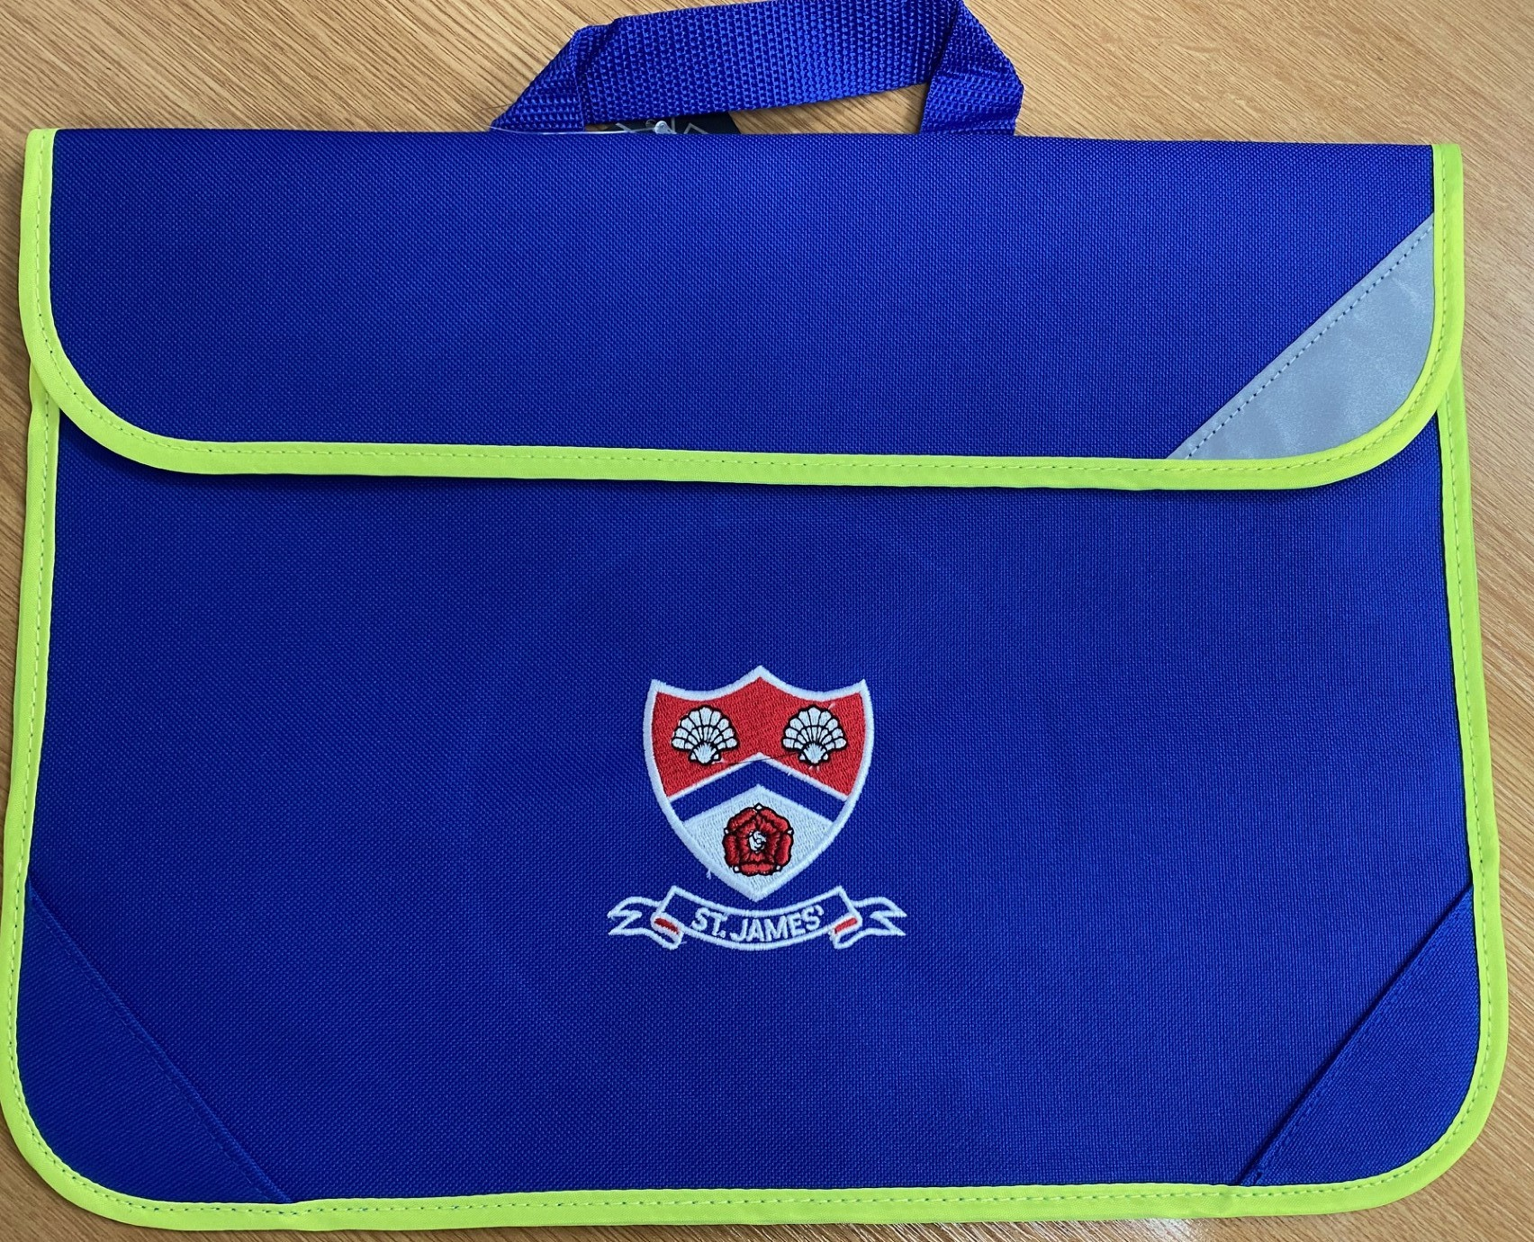
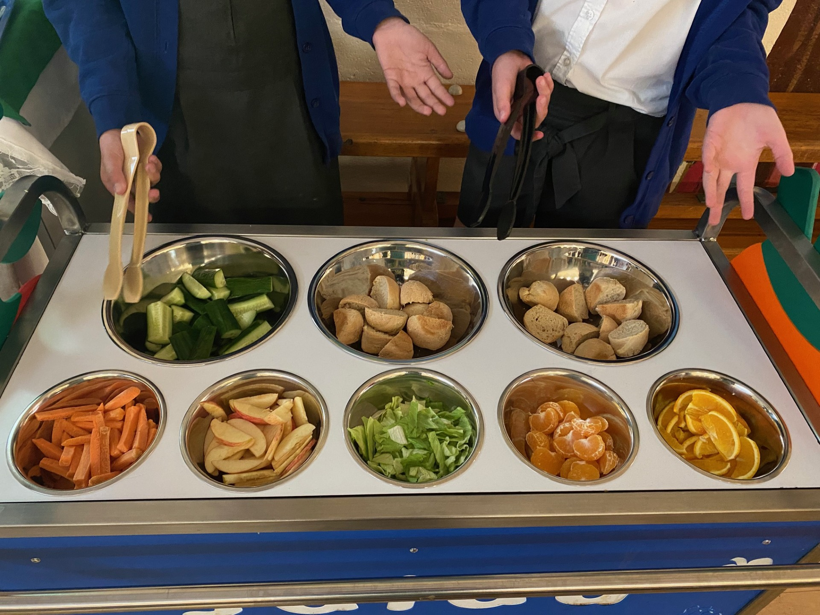
Being Equipped for the Day
Snacks and Drinks
Reception Class has a snack table, where fruit and water are available all day (children may bring their own piece of fruit from home – no grapes due to choking hazard). A carton of milk is provided each morning on arrival into class.
Year 1 and Year 2 are provided with free fruit on a daily basis and are encouraged to bring a bottle of water to school each day.
Blue Reading Bags
Your child will often have books or other equipment to carry to and from school. To ensure everything remains in good condition your child will be provided with a blue reading bag. This should be brought to school every day and checked every evening for letters from the school. The first blue bag will be provided free of charge, with replacements available from the office at a small charge.
Medicines in School
There are occasions when children need to take medicines even though they are well enough to attend school. However, if children require medicine, parents are advised to arrange doses around the school day e.g. Breakfast time, tea-time and bedtime. If children do require medication during the school day, parents should make arrangements with school via the school office.
If you child requires an inhaler for asthma, please let the class teacher know so that it can be kept in an agreed place where it is accessible for your child.
First Aid
Many of our staff are qualified in Paediatric First Aid. If you child has an accident in school, first aid will be administered by a full trained member of staff and a slip sent home.

Slide 10
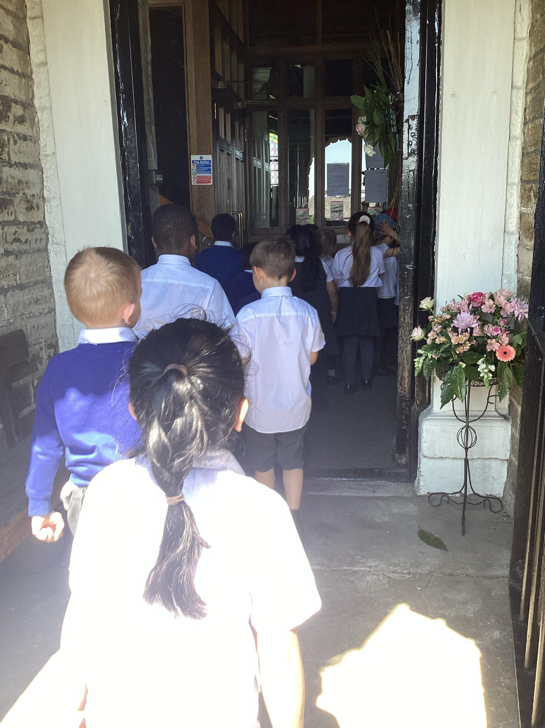
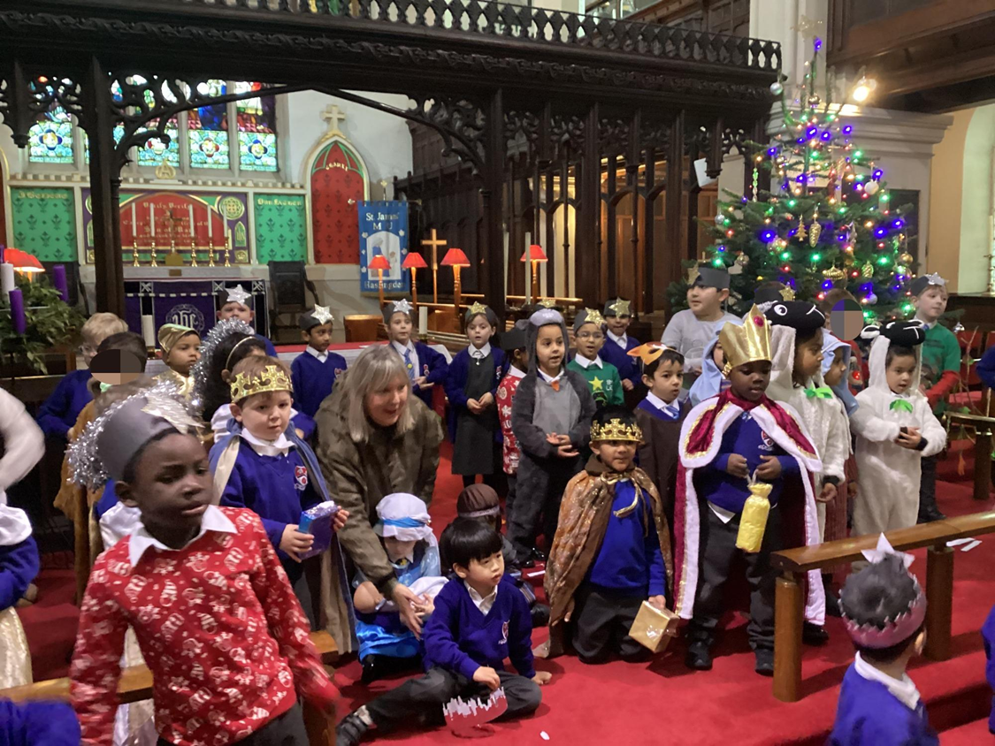
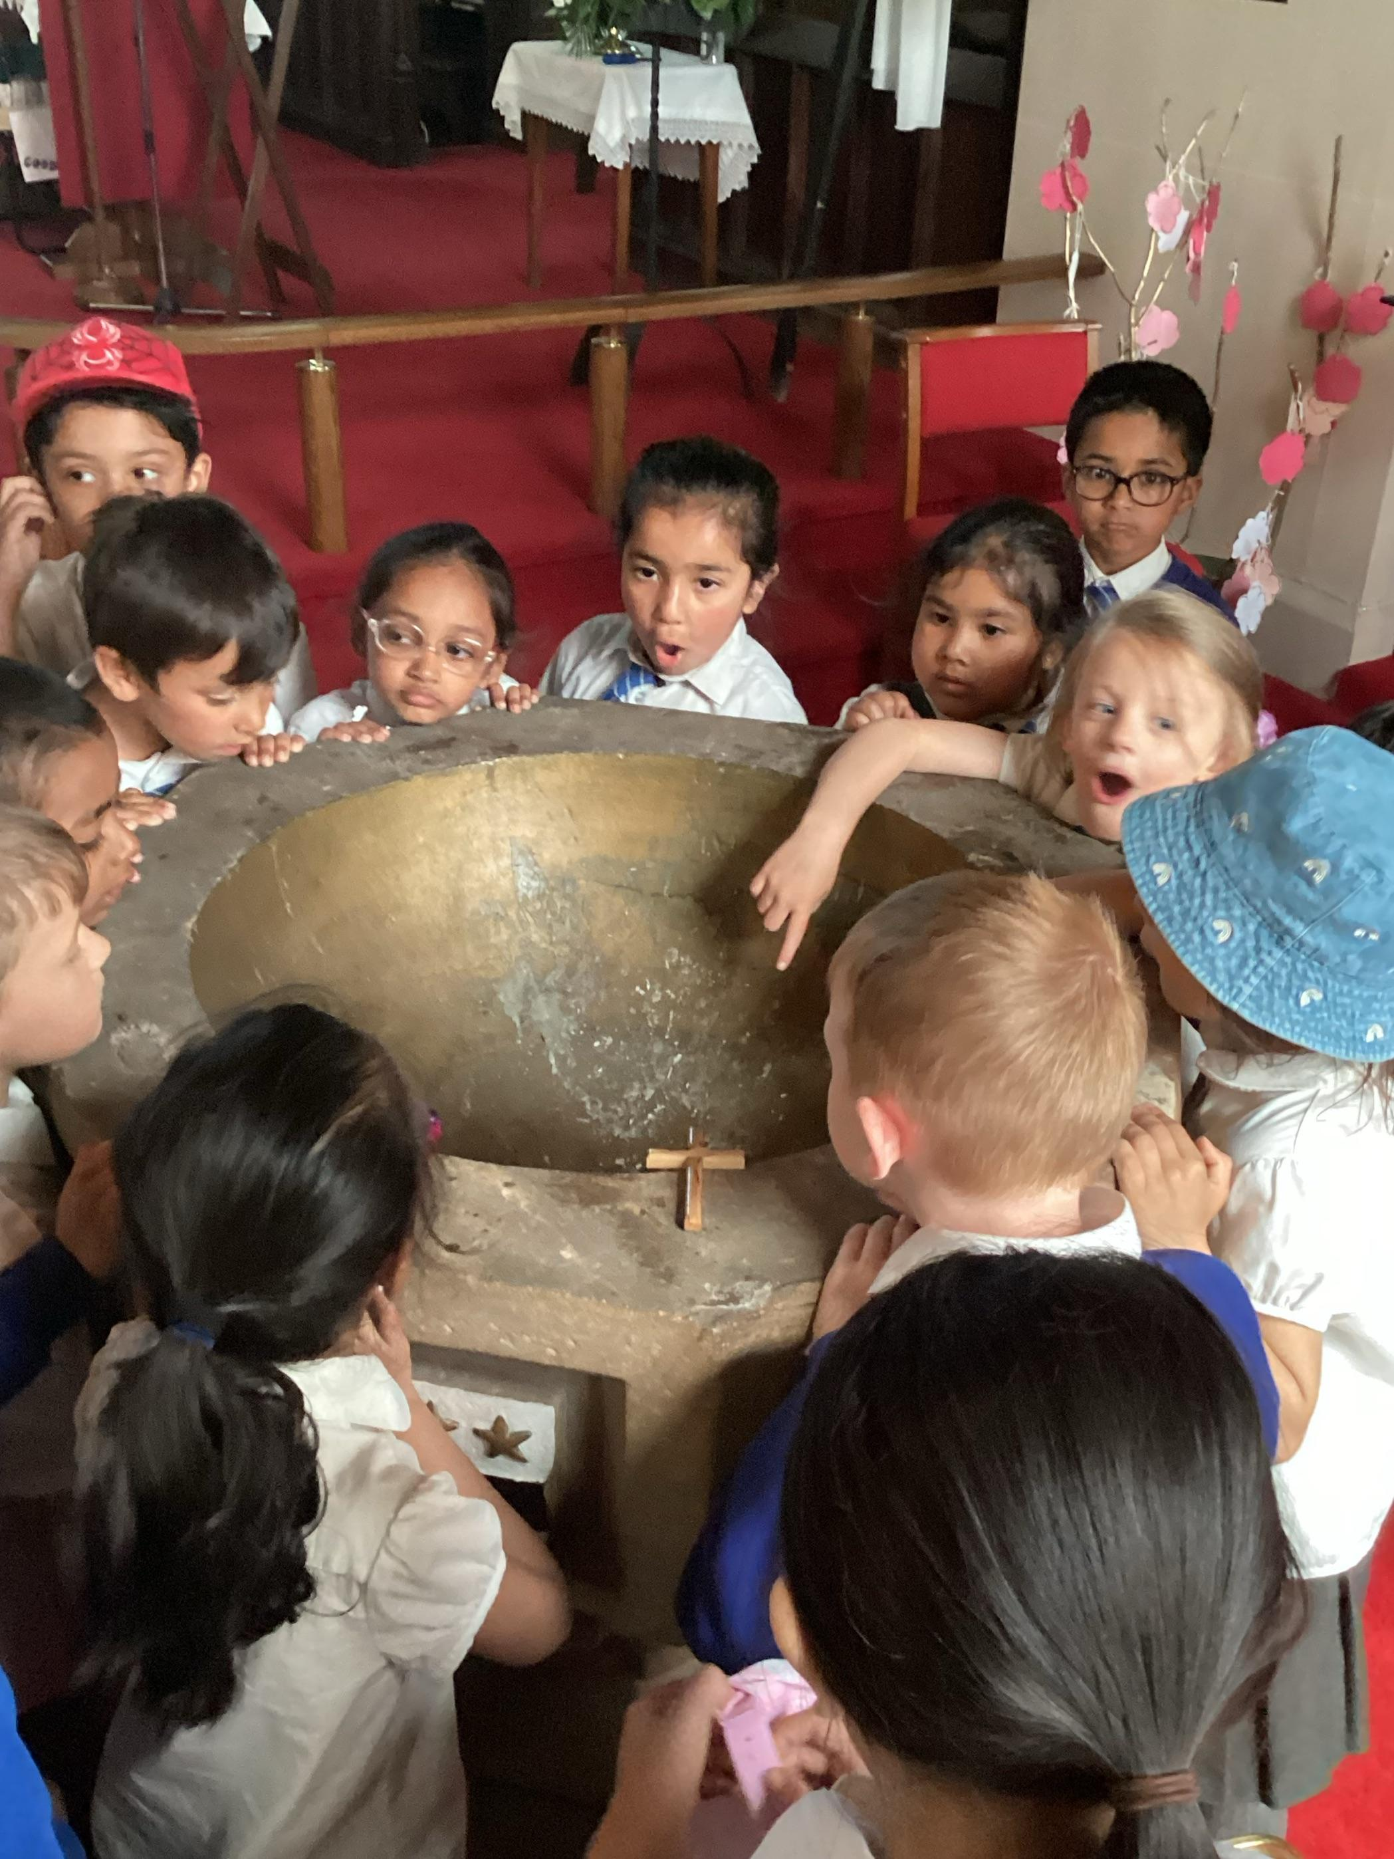
Links with St. James’ Church and Collective Worship
St. James’ is a Church of England Voluntary Aided school and has strong links with the local church of St James’, which is situated on Church Lane. The vicar is a regular visitor to the school and we worship in church as often as we can throughout the year, including Easter, Christmas, Harvest and for our end of year service.
A daily act of worship is held in school. This is broadly Christian, rather than being narrowly Anglican. Worship is planned around the church year and a variety of religious and moral themes, including the core values identified by the school which are shared by all members of the school community, irrespective of personal faith.
Members of St James’ Church, other churches and organisations are welcomed on a regular basis.
On Fridays, our act of worship incorporates our Celebration Assembly when a range of achievements are celebrated together. Parents and friends are invited to join us on a half termly basis to share the children’s successes.
We believe that it is an important part of the children’s development to play an active part in the life of the church. We welcome and appreciate the support and attendance of parents in at all services.

Slide 11
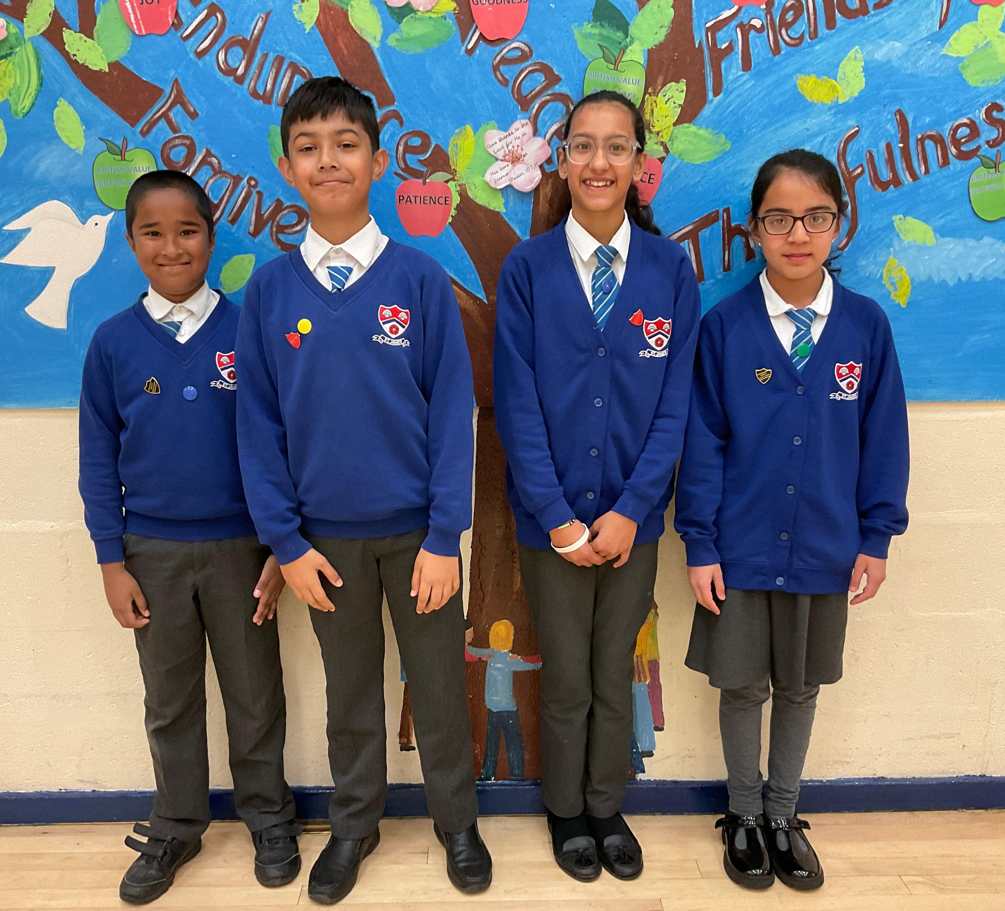
School Uniform
St James’ has a school uniform which all children are expected to wear and be proud of.
ALL ITEMS OF CLOTHING, INCLUDING THE PUMP BAG & BOOK BAG SHOULD HAVE THE CHILD’S NAME CLEARLY MARKED
Weather
Warm coats, hats, gloves and scarves should be worn during cold weather, sun hats should be provided in sunny weather. Gingham summer dresses are not part of the uniform at St James.
Headscarves
These may be worn for religious reasons to and from school but must be in plain colours – black, blue or white, and removed during School time for Safety Reasons.
All other items are available to buy from local shops, supermarkets & Abbey Street shopping centre Uniform shop, Accrington. Additional ties can be bought from the school office.
Boys | Girls
Dark Grey Trousers or grey shorts | Dark Grey Skirt or tailored grey trousers
White short sleeved collared shirt | White short sleeved collared shirt
School royal blue V neck jumper | School royal blue V neck jumper or cardigan
School tie | School tie
Black school shoes(no trainers) Reception class Velcro fastenings please | Black school shoes(no trainers) Reception class Velcro fastenings please
Dark socks | Black, grey, blue tights/white or grey
PE kit (to be be kept in school at all times)
White crew neck t-shirt
Black shorts or leggings for girls
Black gym pumps (no trainers). Socks to replace tights for girls.

Slide 12
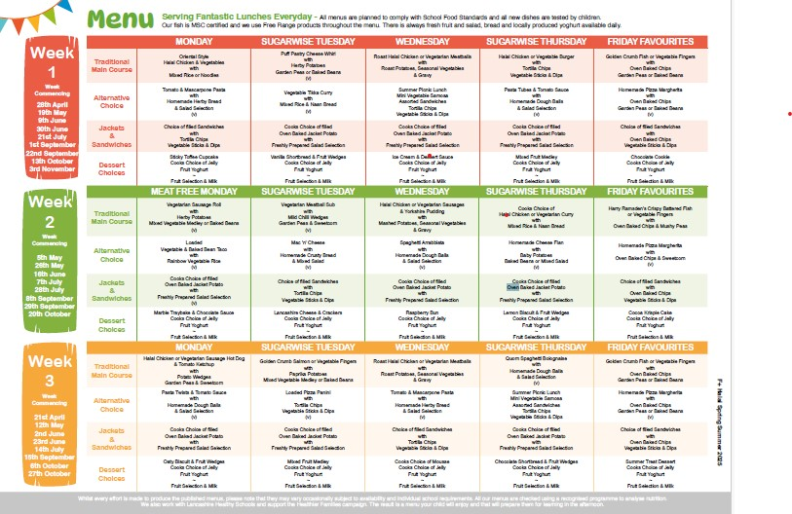
Lunchtime: School Dinners or Packed Lunch
All children in Reception, Year 1 and Year 2 are entitled to a free school meal. You will be given the choice as to whether you would like your child to take their free school meal or whether you would like to provide a packed lunch.
School Dinners
Our meals are prepared by Lancashire County Council Catering Services to their seasonal Halal menu. Our kitchen was fully refurbished in 2024 and premises are accredited by Halal Meat Council. The menu runs on a 3-week schedule containing diverse and healthy choices. Lunchtime staff build rapport with children encouraging them to try new foods and finish meals. We also run a Salad Bar staffed by trained pupils from which children can chose a selection of fresh fruit and vegetable daily. Current cost of school meals is £13 weekly to be paid in advance.
However, if your child really doesn’t like the school meals offered, it may be a more suitable option to provide a packed lunch, hungry children make unhappy children and they are unable to concentrate well in the afternoon session.
Packed Lunch
If you choose to provide a packed lunch, please send your child with a small lunch box and a plastic flask or bottle. In the interests of safety, no glass bottles or cans should be brought in to school. We are working towards being a healthy school and therefore do not allow children bringing fizzy drinks, chocolate or sweets as part of their lunch. Any rubbish or uneaten items will be returned home for checking and disposal.

Slide 13


Financial Support
Pupil Premium Important information
Although all children in KS1 are entitled to receive a free school meal and no application is required to accept this, some children have a statutory entitlement to free school meals. The school can qualify for additional funding called pupil premium worth over £1,000 per child, if the parent is receiving any of the following;
•Income Support
•Income-based Jobseeker’s Allowance
•Income-related Employment and Support Allowance
•Support under Part VI of the Immigration and Asylum Act 1999
•The guaranteed element of Pension Credit
•Child Tax Credit (provided you’re not also entitled to Working Tax Credit and have an annual gross income of no more than £16,190)
•Working Tax Credit run-on - paid for 4 weeks after you stop qualifying for Working Tax Credit
•Universal Credit
If you think you qualify for statutory free school meals, please complete the form on the Lancashire County Council website:
Free school meals - Lancashire County Council
If either parent is registered disabled, please let the school office know.

Slide 14
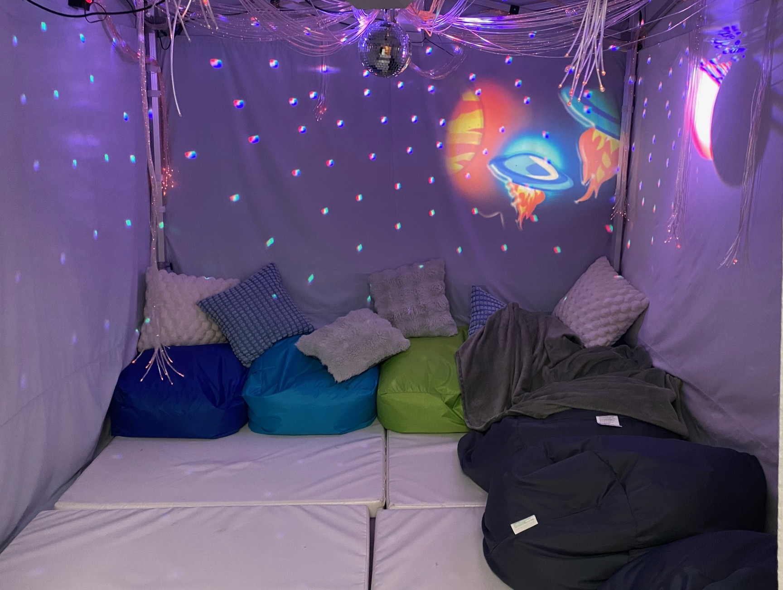
SEND & Family Support
At St. James’ we recognise that every child matters and can succeed. We provide a safe, secure and nurturing learning environment where each child is valued and their individuality celebrated. We are passionate about achieving outstanding outcomes for all learners and committed to educating the ‘whole child’, helping all to flourish and grow in confidence together.
Inclusion/Special Educational Needs
We have a non-teaching full time SENCO called Mrs Kathryn Jamil who is extremely experienced in EHCP process, Early Help referrals, co-ordination of Educational Psychologist services as well as the management of individual care plans school wide.
Our fantastic sensory room in school is accessed by all our children, however this is an essential learning experience for some of our pupils with SEND.
Please contact our SENCO Mrs Kathryn Jamil via the School Office 01706 214134 with any questions or queries you may have or for further support/information.
Family Support
In 2025, we launched a School Community Care Fund in response to the increasing cost of living crisis .This is a long-term charitable project which will direct a significant portion of funds raised in school through collections, fairs, non-uniform days to our families who may be experiencing difficulties. The fund will be a resource to which parents facing difficulty can apply in confidence to receive support via clothing, food, toiletry parcels or other unexpected needs.

